Slide 1


API Interaction
By: Daniele Ricciardelli & Nathaniel Case
Introduction
Company NameInasd
ECE 4317 - Intelligence System for Engineers
Presented to: Dr. Tim Lin
2025
Spring

Slide 2
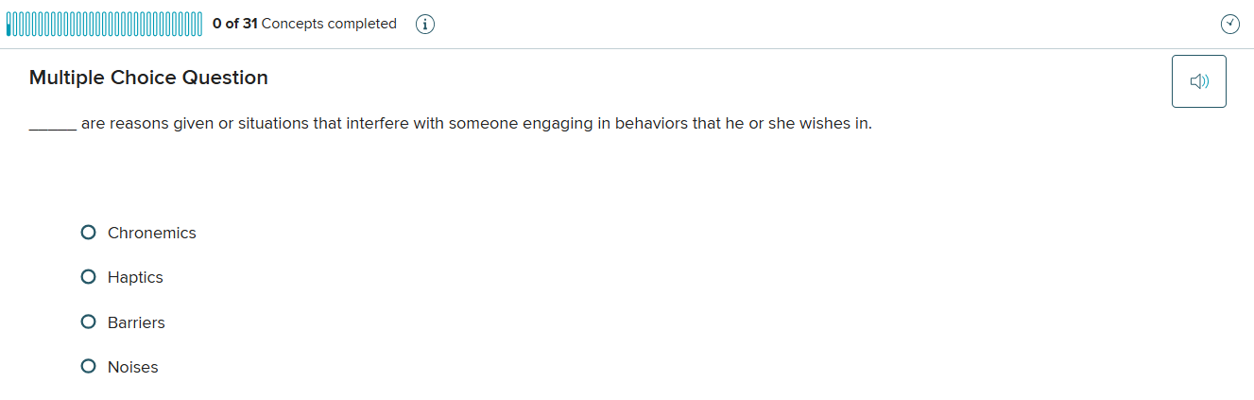
Challenge
An assignment that has over 30 questions (62 in the shown example) implies a lot of work, what if it could be left for AI and automation to get it done?
DISCLAIMER: We discourage any individuals of entities to use this for any reason - this is just a proof of concept. Any misuse of our script are subjected to the full extent of the law or rules of the institution

Slide 3
Script
How we tackle it? We need:
Access to the LLM API
Automate the find of a target
Read the target (give it eyes)
Decrypt the image to text if needed
Automate the API to read it
Push an answer
Ability to replicate
Fully automate it

Slide 4
1
2
3
4
5
Access to API
Access/Read to images
Automate target finding
Automate replication
GUI
The most important part is that we need access to the API.
We need to give eyes to the brain. Later, connect these two.
Once able to read images, now we need to automate targets
Add automatic answer selection
A GUI to make it easier for distribute and usage for all type of users
Install openAI library
Install image/screenshot automation and OCR
Install pygetwindow to detect desired windows/tabs
Install OpenCV to find answer boxes
Creation of history chat to read responses
Pay for API usage and create a API key
Enable google engine for image decryption
Implement code to select desired window.
Implement code to select the correct answer
Ability to re-start the process
Implement API key to our code, and understand basic controls
Verify/Test image read
Give access to the read/decrypt image to the target
Implement code to auto repeat selection process
Ability to manually input

Slide 5
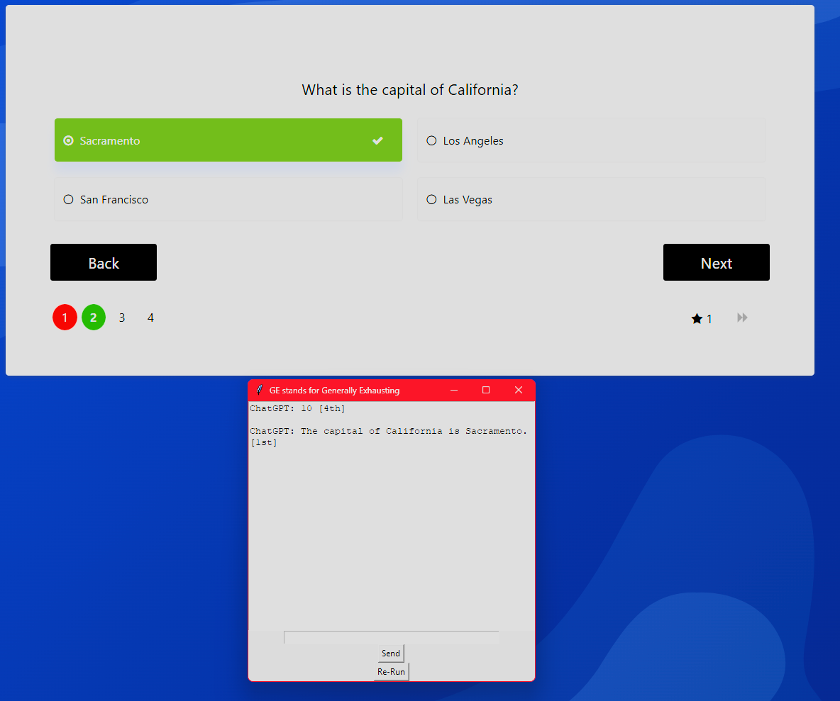
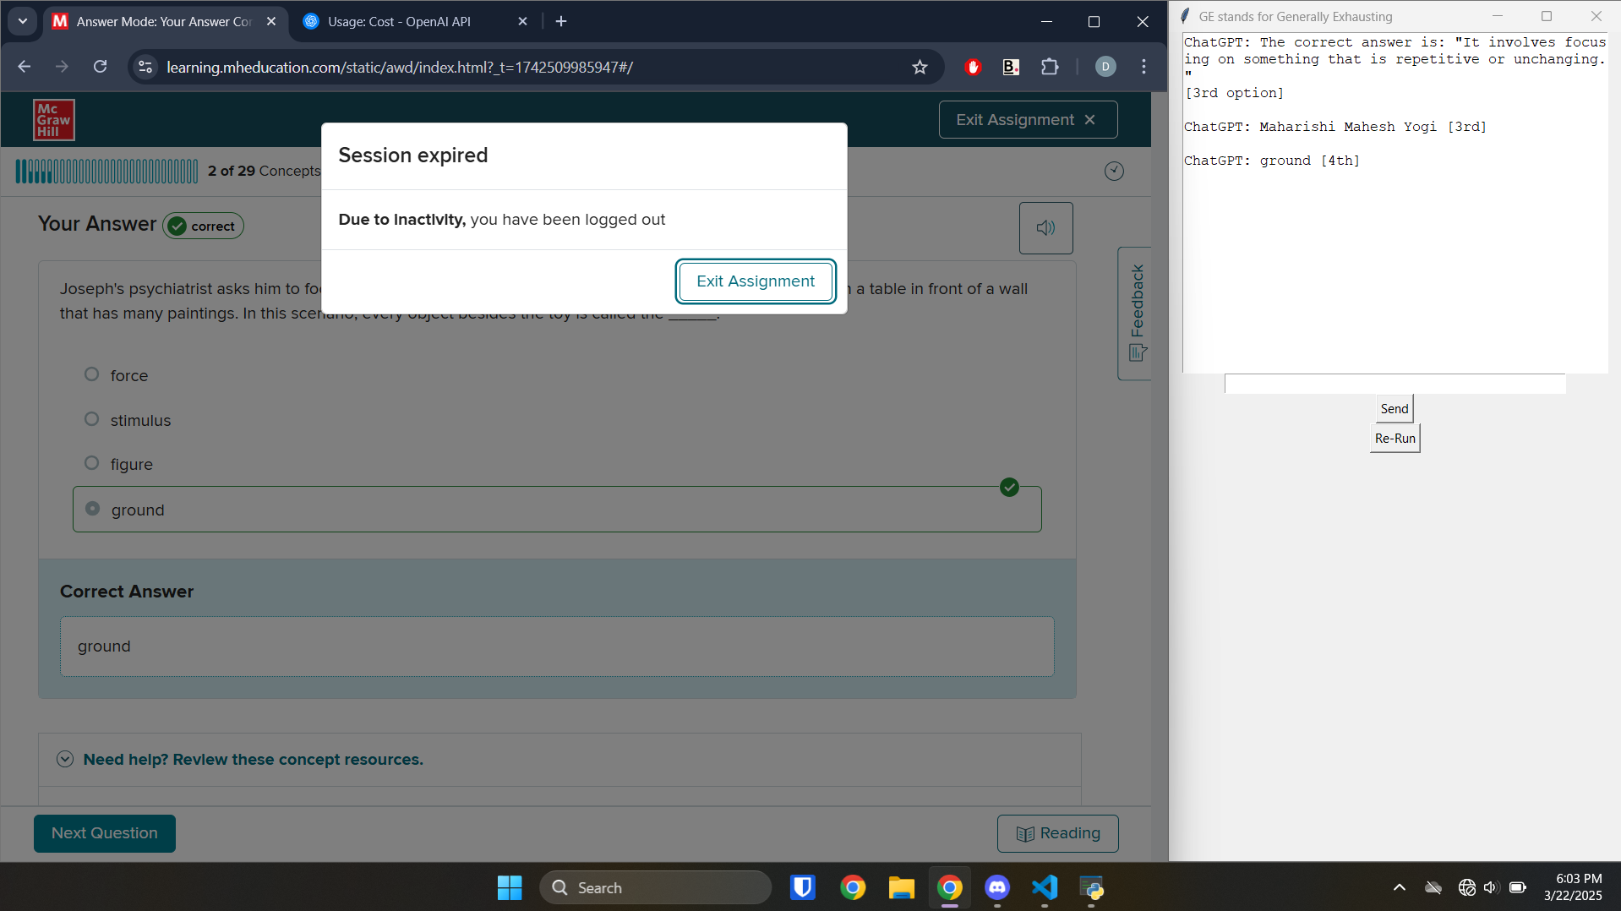
Results
We will demonstrate this in-class

Slide 6
Findings
METRICS
TOP 1
GPT 4o
Best balance between efficiency and performance. Above or equal to 500 tokens (for base reads)
TOP 2
GPT 4 Turbo
Best efficiency in tokens usage, same results as 4o with 200 to 500 tokens
TOP 3
o3-mini
Thinks too much and results are not always accurate. Reasons “less” than mini-high
TOP 4
o3-mini-high
This way too much and the usage of tokens truly varies. Over 2000 tokens for fair answer
TOP 5
GPT 4.5
Not really that good, requires over 1000 tokens usage for “good” results

Slide 7
Conclusion
Strengths
Weaknesses
– Eliminates the process of copy-paste text
– Eliminates the need of a screenshot
– It can be cheaper than buying a $20 subscription to OpenAI
- It could do someone’s homework?
- It can be used by anyone (when packaged as an app)
– As it is programmed, it is limited to one tab at a time
– As it is programmed, it lacks memory
– As it is programmed, it could lead to false positives due to the max tokens cap. (Even though this can be easily adjusted)
Opportunities
Threats
– If further developed, it can be used as a co-pilot for Chrome
– At the increase of the given models given (recently implementation of 4.5 to all API users), we could see self-updating plugins
– If the findings of these are shared, many might benefit from the usage of tokens instead of a subscription
– The misuse of this script, and the lack of proper due diligence on the script, might lead for quick exhaustion of tokens
– The script could be used to inflict given rules and codes by entities like schools or workplaces as it can be run w/o access to chatgpt.com

Slide 8
Thank you for listening!
Final slide :)
Contact Daniele Ricciardelli: ricciardelli@cpp.edu
Nathaniel Case: ncase@cpp.edu

